Slide 1
What is a World Heritage Site?

Slide 3
The ‘World Heritage List’ - UNESCO
To be included, sites must have
‘outstanding universal value’
either 1) natural beauty
or 2) importance to human culture

Slide 4
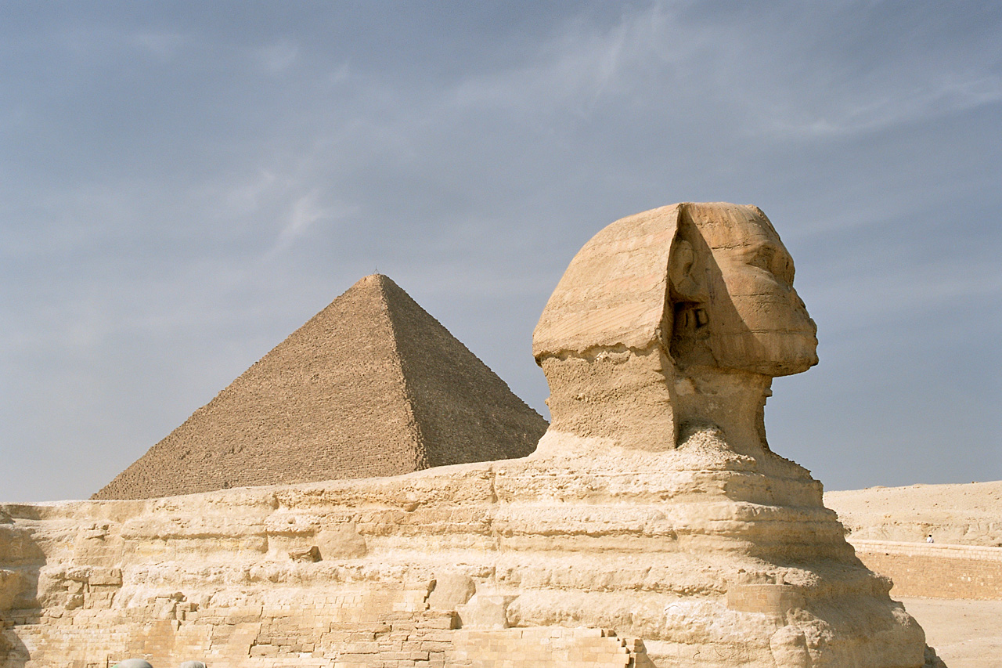
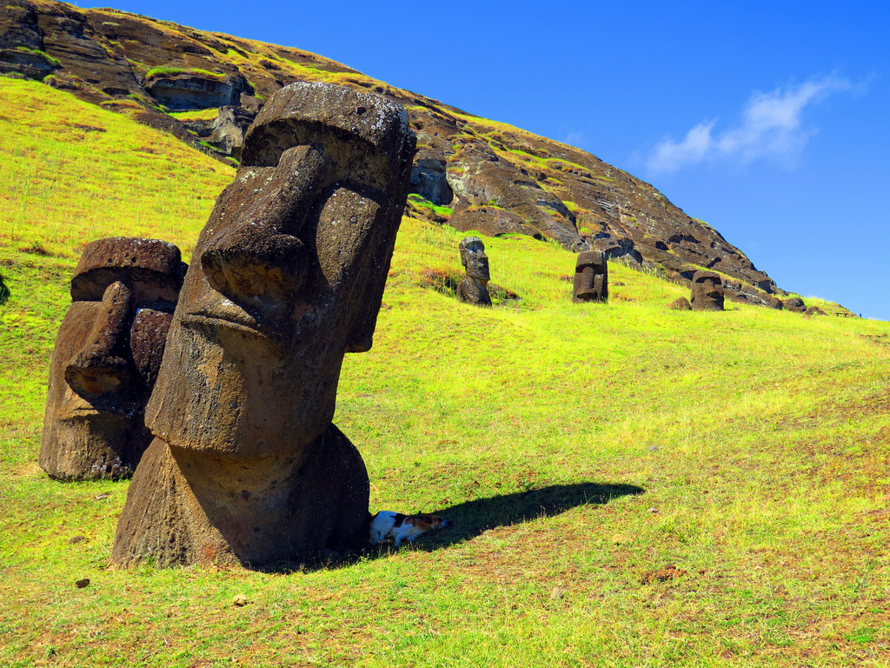
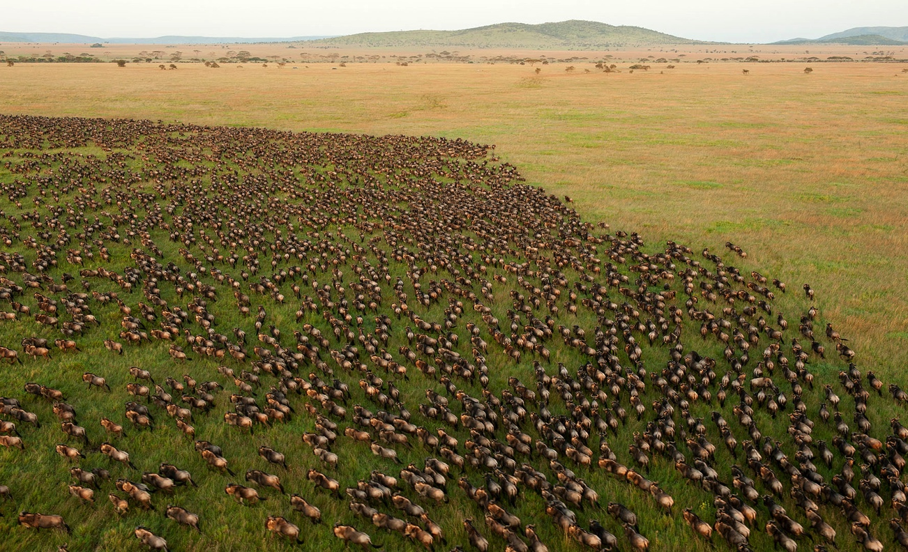
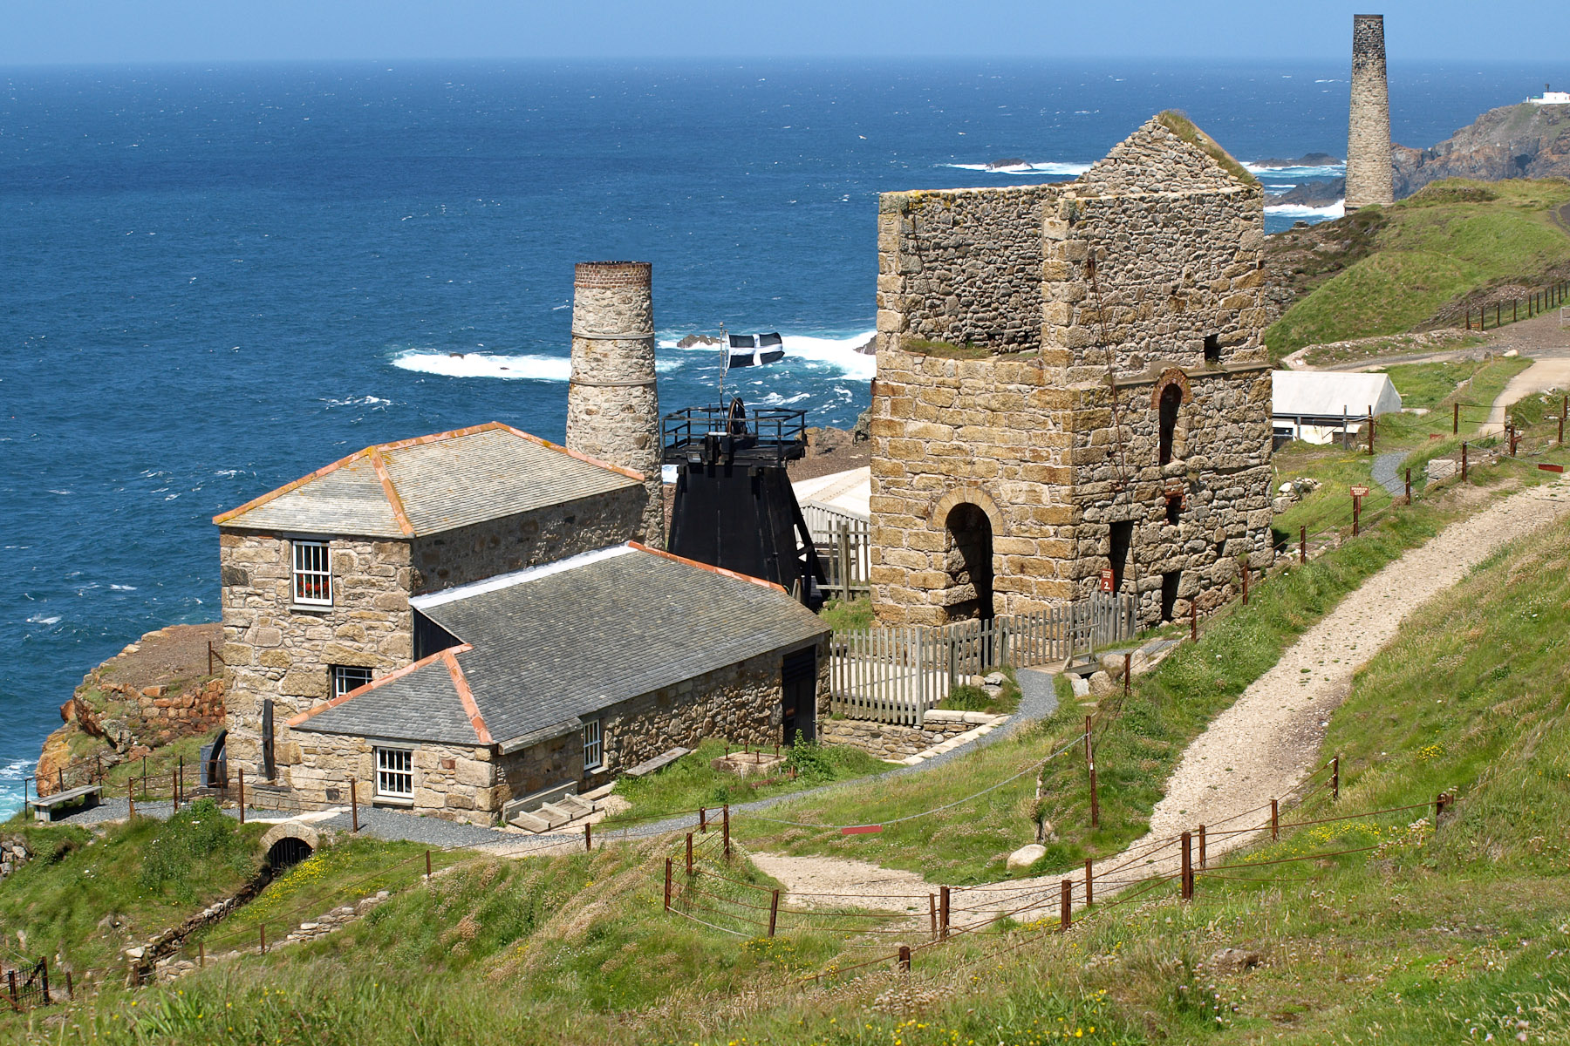
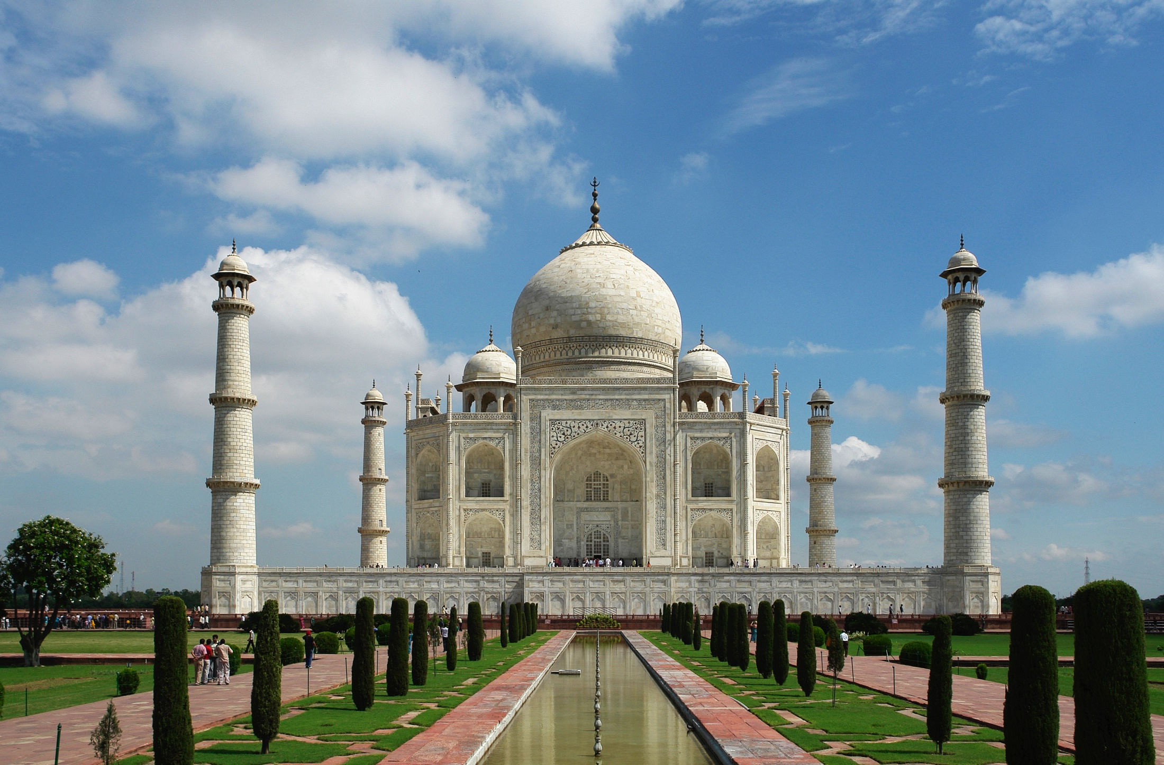

Slide 5
Why is the Cornish Mining Landscape a World Heritage Site?

Slide 6
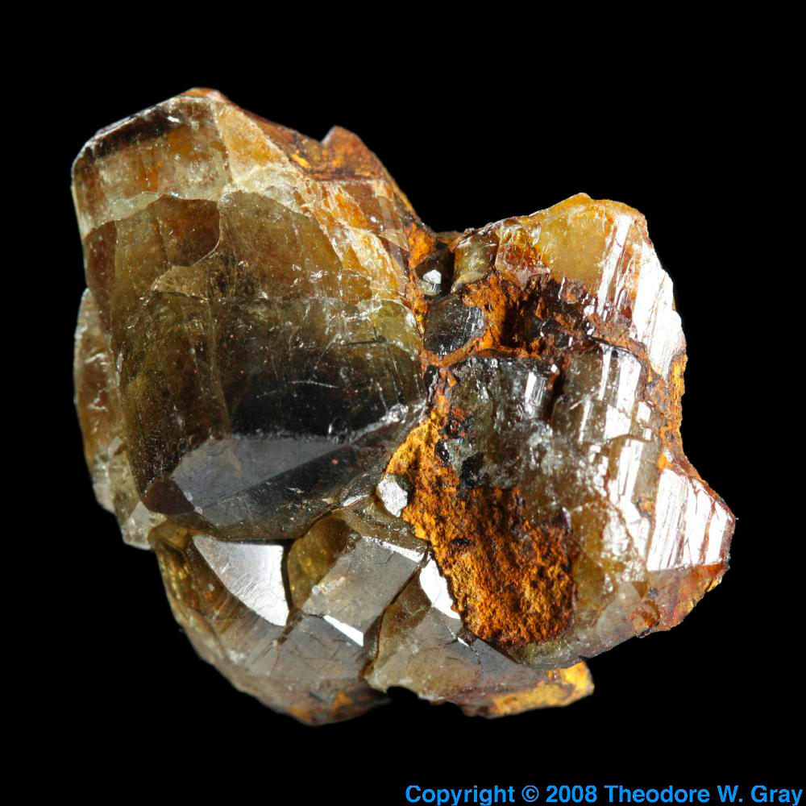
Earth Treasures
Cornwall has some of the richest underground minerals anywhere in the World:
Copper, Silver, Lead and Tin
but also
Antimony, Arsenic, Bismuth,
Cobalt, Gold, Iron, Lithium,
Manganese, Nickel, Titanium,
Tungsten, Uranium,
Wolfram, Zinc … etc

Slide 7
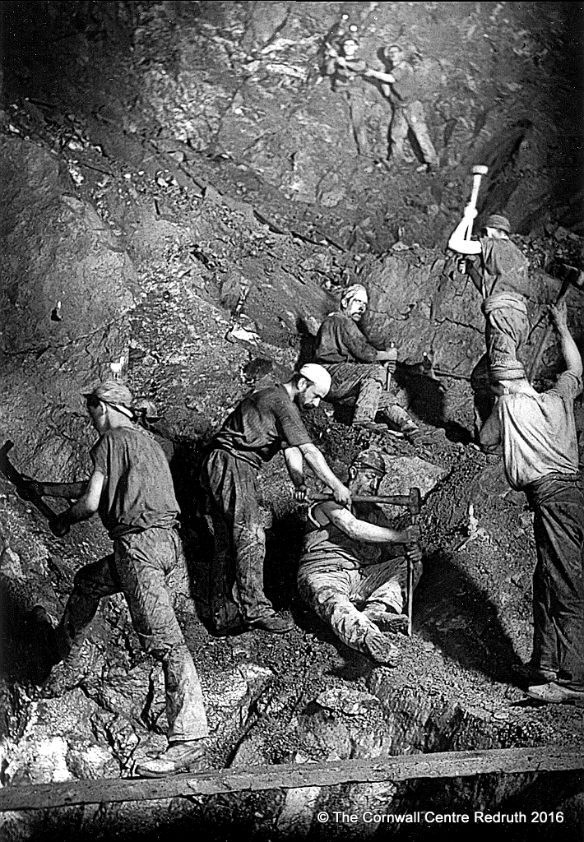
People
Cornish Mining was
dirty dark and difficult.
But the characters
involved often had
extraordinary stories
to tell…

Slide 8
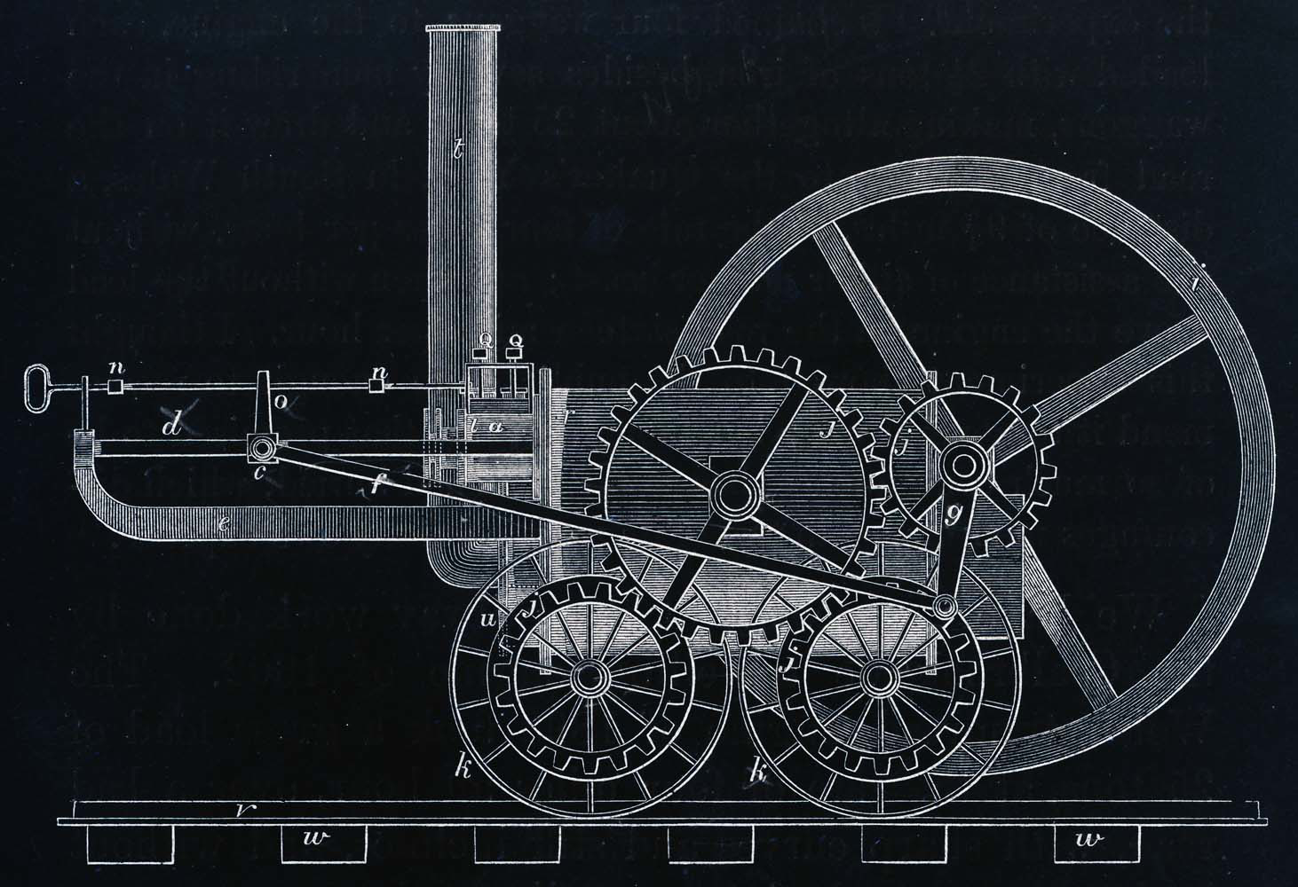
Inventions
Cornish Mining gave birth
to technology which
helped shape the world
we live in today
Richard Trevithick
invented the world’s first
Steam Locomotive in 1801

Slide 9
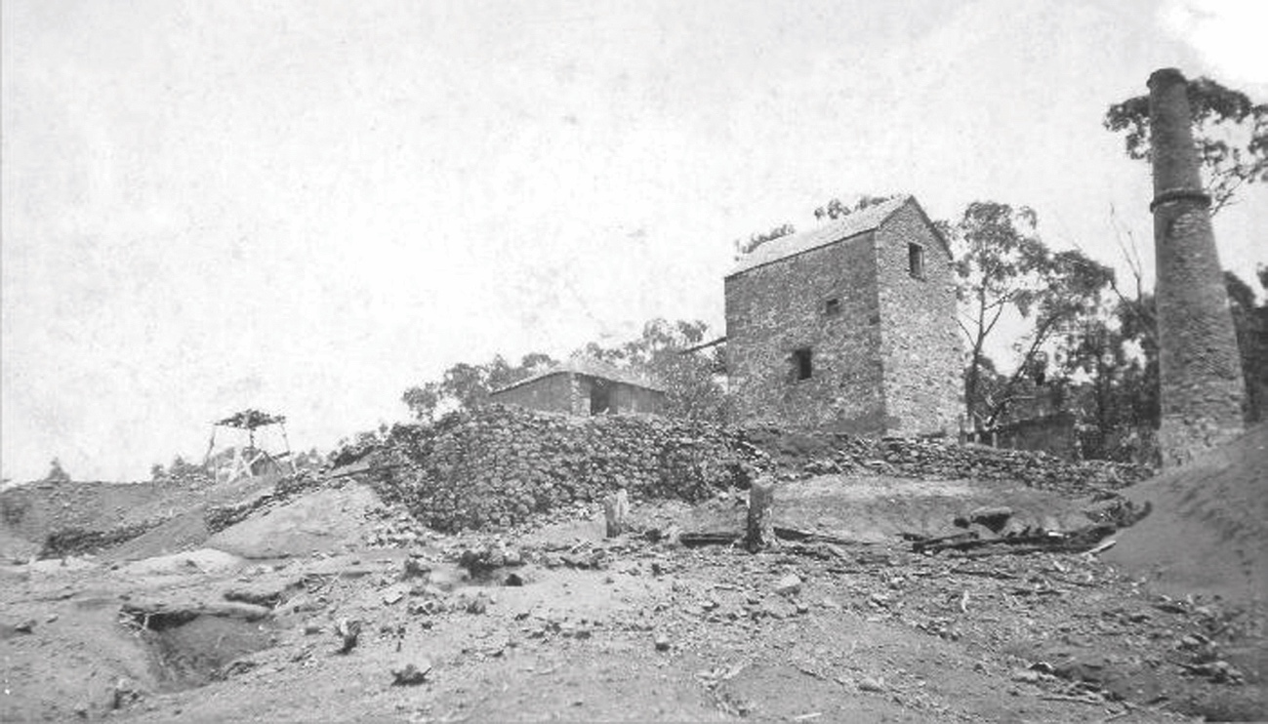
Worldwide Influence
Cornish Mining’s influence
can be seen around the
whole wide World
There are at least 175 places,
in 44 different countries
where Cornish miners took their
skills, technology and culture

Slide 10
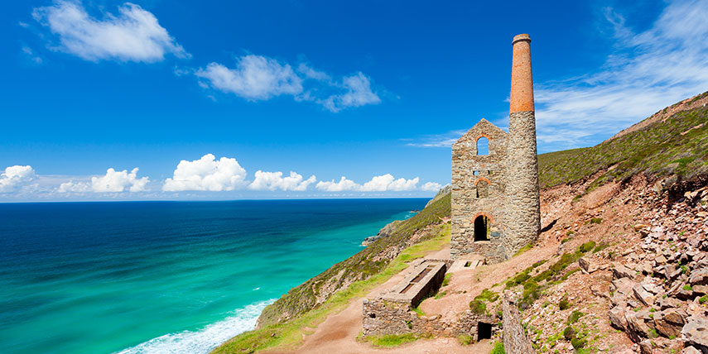
There is plenty more to discover about why the
Cornish Mining
Landscape is a
World
Heritage
Site …

